Slide 1
Objectives
Which features are most helpful in predicting malignant or benign cancer;

Slide 2
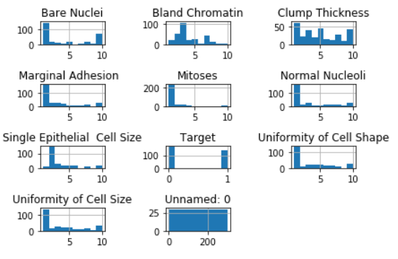
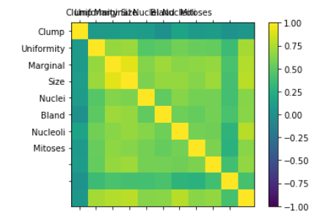
Visualization of Data
Notes:
#163 benign, Malignant 137
# Univariate Histograms
from matplotlib import pyplot
from pandas import read_csv
filename = 'breast_cancer_data.csv'
names =['Clump', 'Uniformity', 'Marginal','Size','Nuclei','Bland','Nucleoli','Mitoses']
data = read_csv(filename)
data.hist()
pyplot.tight_layout()
pyplot.show()

Slide 3
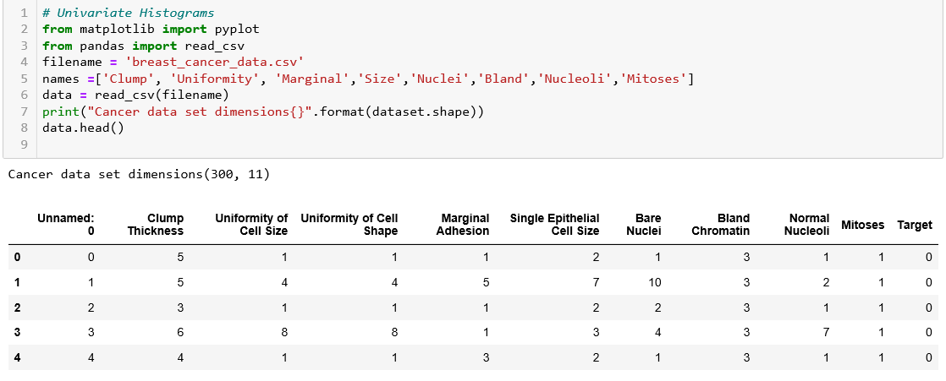
Data Preparation

Slide 4
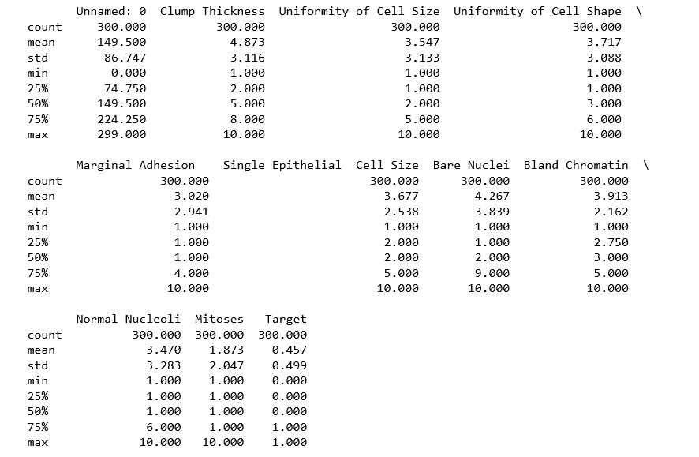
Data Preparation

Slide 5
Feature Selection Using RFE:

Slide 6
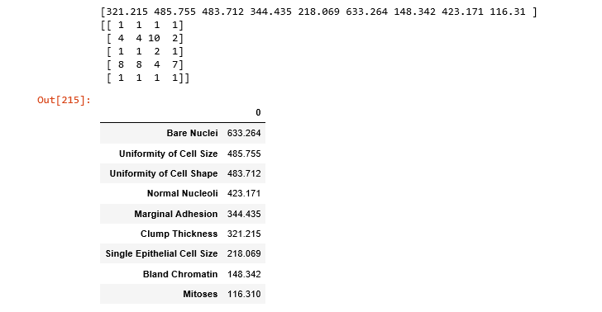
Feature Selection with Univariate Statistical Tests

Slide 7
Modelling

Slide 8
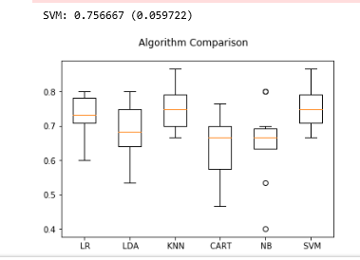

Result of Algorithm Comparison
Result of Evaluation Using Cross Validation

